Slide 1
NAME:
CLASS PERIOD:
PHOTOSYNTHESIS AND CELLULAR ANIMAL RESPIRATION PROJECT

Slide 2
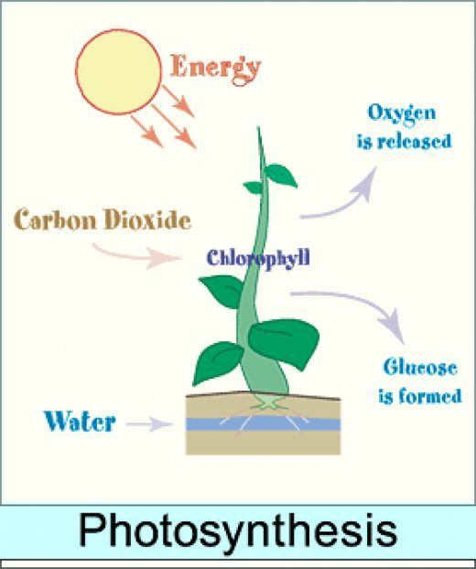
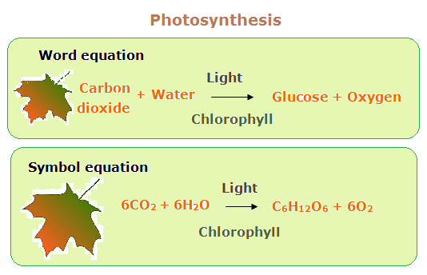
PHOTOSYNTHESIS is the process used by GREEN PLANTS, ALGEA and certain BACTERIA to harness energy from sunlight and turn it into chemical energy.

Slide 3
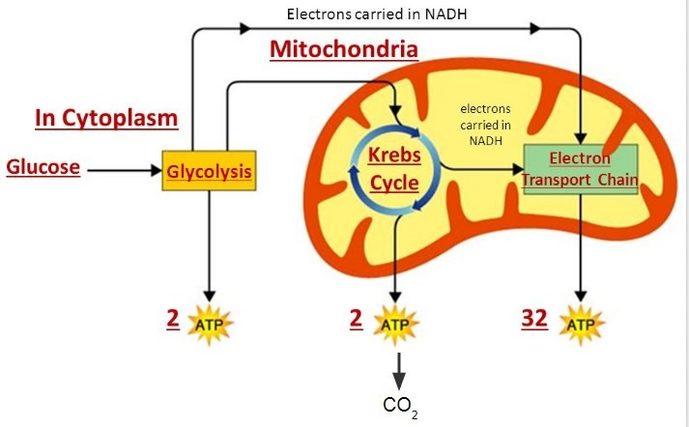
Cellular respiration is the process through which cells convert sugars into energy. To create ATP and other forms of energy to power cellular reactions, cells require fuel and an electron acceptor which drives the chemical process of turning energy into a useable form

Slide 4
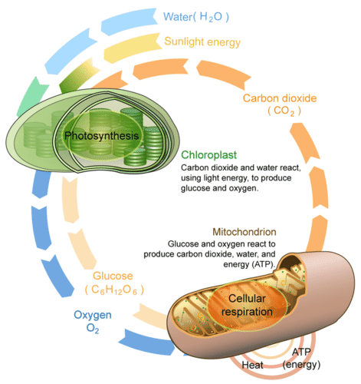
&
Relationship
PHOTOSYNTHESIS
RESPIRATION
BETWEEN

Slide 5
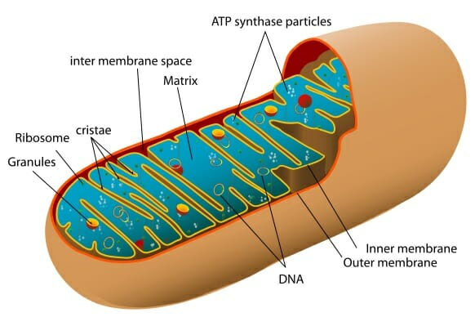
MITOCHONDRIA

Slide 6
DIFFERENCES BETWEEN ANAEROBIC AND AEROBIC RESPIRATION
AEROBIC RESPIRATION TAKES PLACE IN THE PRESENCE OF OXYGEN WHILE ANAEROBIC RESPIRATION TAKES PLACE IN THE ABSENCE OR LIMITED OXYGEN SUPPLY
The end products of aerobic respiration are carbon dioxide, water, and energy. The end products of anaerobic respiration are acids, alcohols, gases, and energy
A total of 38 ATPs are produced during aerobic respiration, some of which are lost during the process. Only 2 ATPs are formed during anaerobic respiration.

Slide 7
WHAT CELLULAR PROCESS DOES FERMENTATION CLASSIFY AS?
ANAEROBIC RESPIRATION SINCE FERMENTATION OCCURS IN THE ABSENCE OF OXYGEN

Slide 8
WHAT IS THE FUNCTION OF ATP IN CELLS?
Adenosine triphosphate (ATP), energy-carrying molecule found in the cells of all living things. ATP captures chemical energy obtained from the breakdown of food molecules and releases it to fuel other cellular processes.

Slide 9
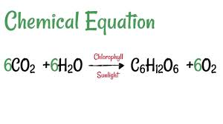
PHOTOSYNTHETIC EQUATION

Slide 10
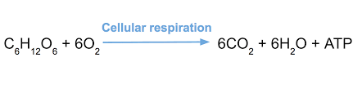
RESPIRATION EQUATION

Slide 11
RELATIONSHIP BETWEEN RESPIRATION AND PHOTOSYNTHETIC EQUATIONS
Notice that the equation for cellular respiration is the direct opposite of photosynthesis:
Cellular Respiration: C₆H₁₂O₆ + 6O₂ → 6CO₂ + 6H₂O.
Photosynthesis: 6CO₂ + 6H₂O → C₆H₁₂O₆+ 6O

